Slide 1
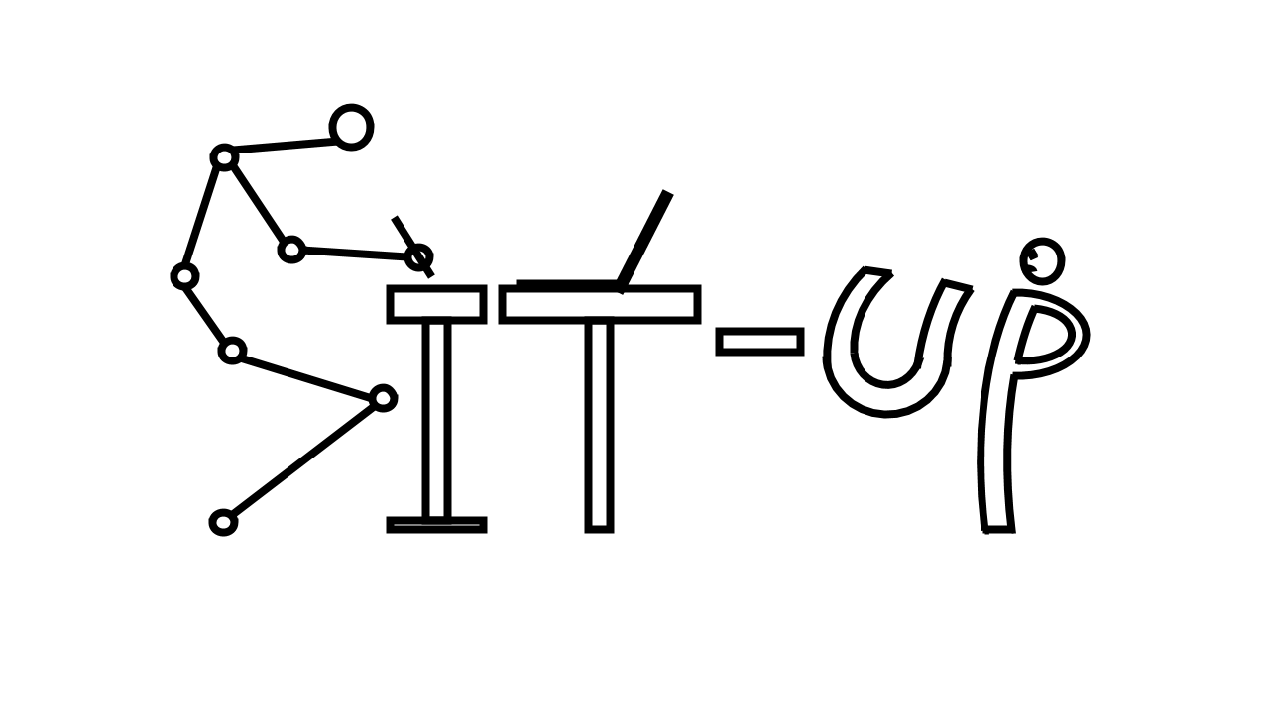
Sit-Up!
The personalized AI posture practitioner

Slide 2
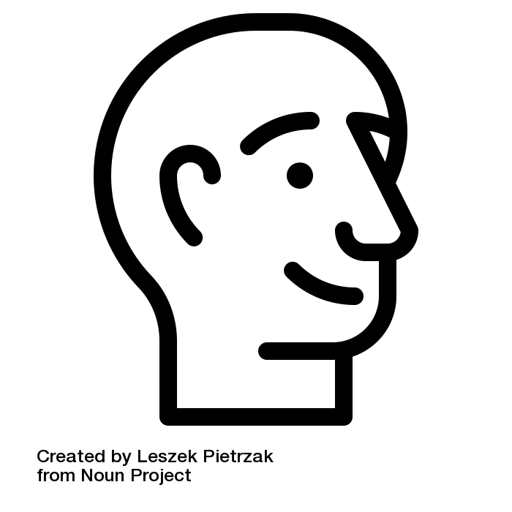
≈
10 pounds
[4.5 kg]

Slide 3

2 inch
≈
+ 9 L
Notes:
Add animation. The head rotates

Slide 4
PROBLEM INTRODUCTION
How bad posture can affect you ?
80%
of adults are suffering back pain caused by bad posture
86bil.
of low-back pain cost in US each year
Main Health Effects
Back, Neck, and Shoulder Pain
Poor Circulation
Increased Stress
Fatigue and Low productivity
$30,000
is spent on posture-related injuries per patient
67% posture-related injuries
33% Other work injures

Slide 5
CURRENT SOLUTIONS FOR POSTURE CORRECTION
The current products are still not effective to fully solve posture problems
Posture brace
Ergonomics furniture
Muscle contraction detector

Slide 6


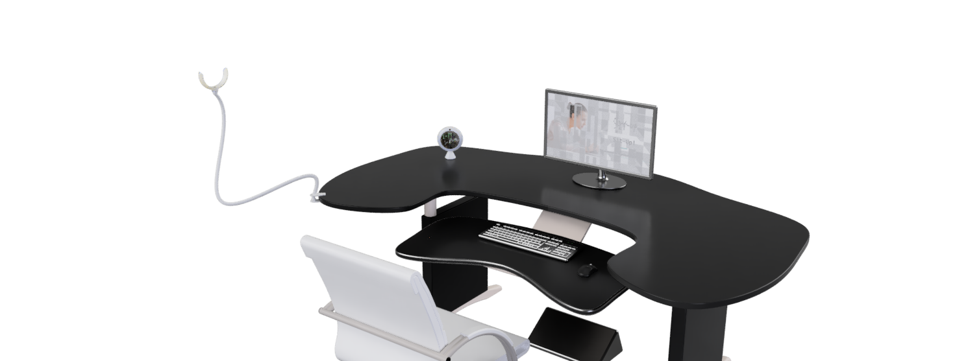
Sit-Up!
The personalized
AI posture practitioner

Slide 7






THE PROCESS OF USE
Sit-Up! – How it works?
User
Long-term Feedback
Detection by computer vision
Posture Assessing Deep Learning Model
Collect data and Record stats
Instant Feedback

Slide 8



PRODUCT ADVANTAGE
Sit-Up! - The AI-powered device achieves flexibility, cost-effectiveness and high accuracy
Simple
&
Flexible
Robust
&
Accurate
Cost-effective

Slide 9
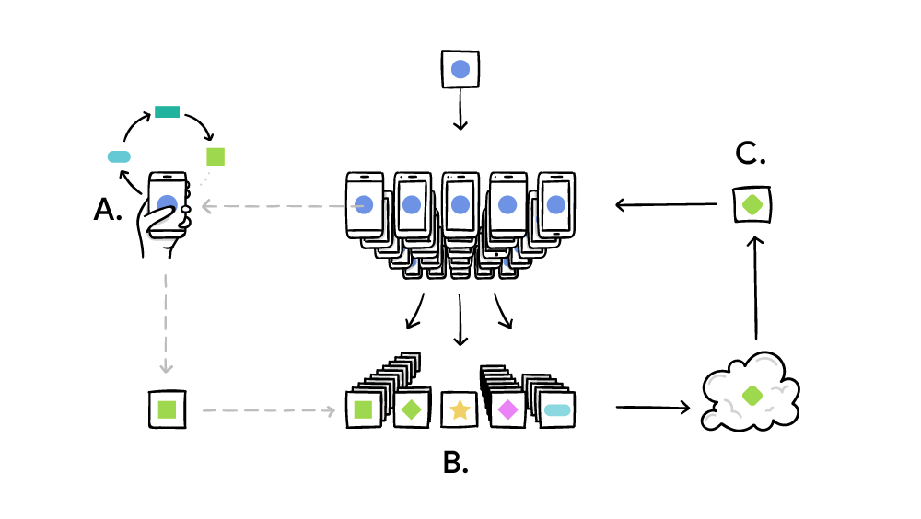
COUNTERING SURVEILLANCE CRISIS
Federal Learning ensures Security and Privacy

Slide 10
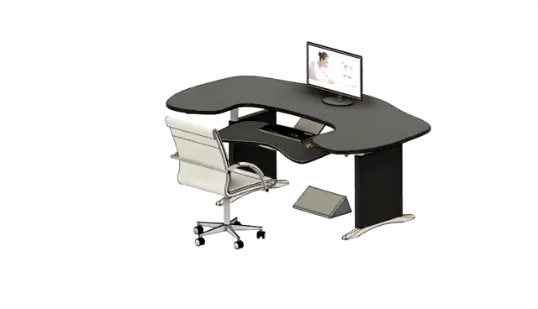
DEMO
Sit-Up! – Presenting…

Slide 11

Q&A

Slide 12
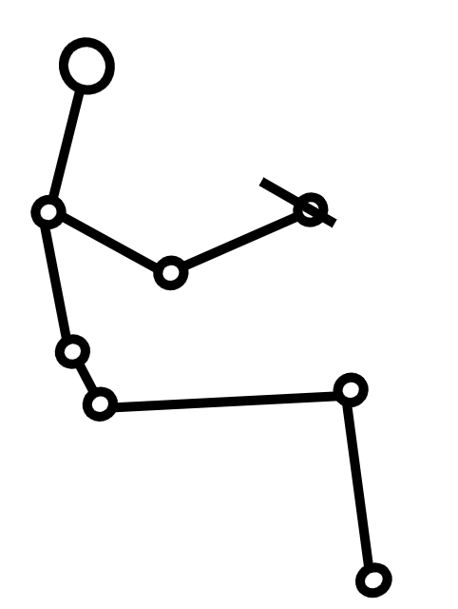
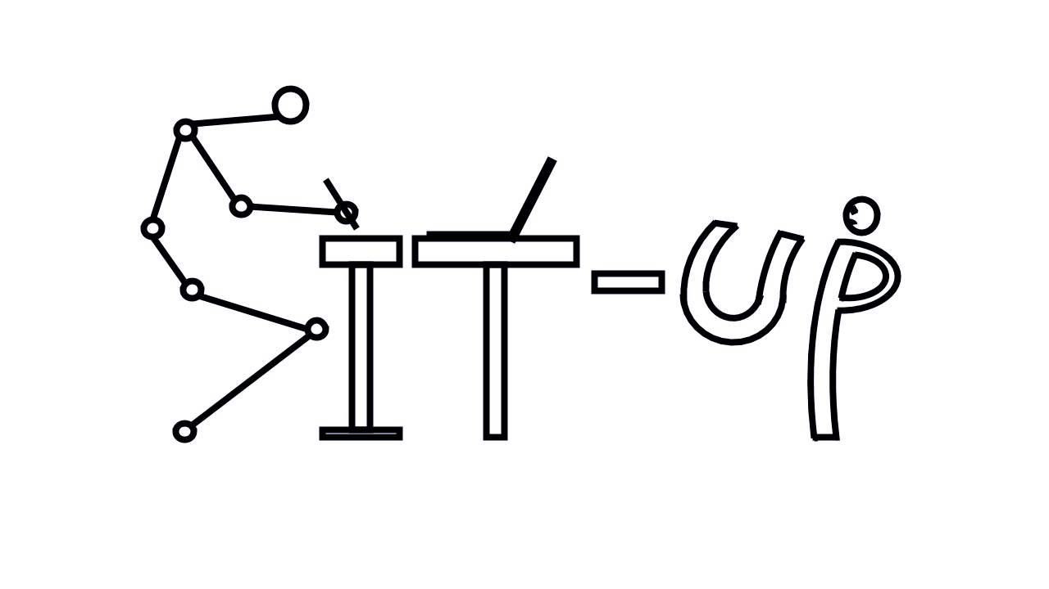
APPENDIX
Backend Process
Input
Input
Camera
Model
Matching algorithm:
OpenPose
Input
Output
Correct model
Tolerance
Comment

Slide 13
APPENDIX
Demo interface

Slide 14
REFERENCE
Presentation
https://www.health24.com/Medical/Backache/Good-posture/Slouching-a-real-back-breaker-20120721
https://www.mensjournal.com/health-fitness/4-reasons-stop-slouching/
https://www.thegoodbody.com/back-pain-statistics/
https://www.acatoday.org/Patients/What-is-Chiropractic/Back-Pain-Facts-and-Statistics
https://www.therooststand.com/blogs/the-roost-blog/12381213-the-cost-of-poor-posture
https://www2.deloitte.com/us/en/insights/industry/technology/technology-media-and-telecom-predictions/2020/ai-chips.html
https://www.techinsights.com/blog/apple-iphone-5s-teardown
https://ai.googleblog.com/2017/04/federated-learning-collaborative.html
https://towardsdatascience.com/federated-learning-and-privacy-preserving-ai-fcddbeb426c5
Backend
https://cmu-perceptual-computing-lab.github.io/foot_keypoint_dataset/
https://arxiv.org/abs/1812.08008
https://github.com/CMU-Perceptual-Computing-Lab/openpose

